Slide 2
Augmented Reality and Virtual Reality within Service Stores. Team members: Paula C. Feio and Renato B. Andrade.

Slide 3
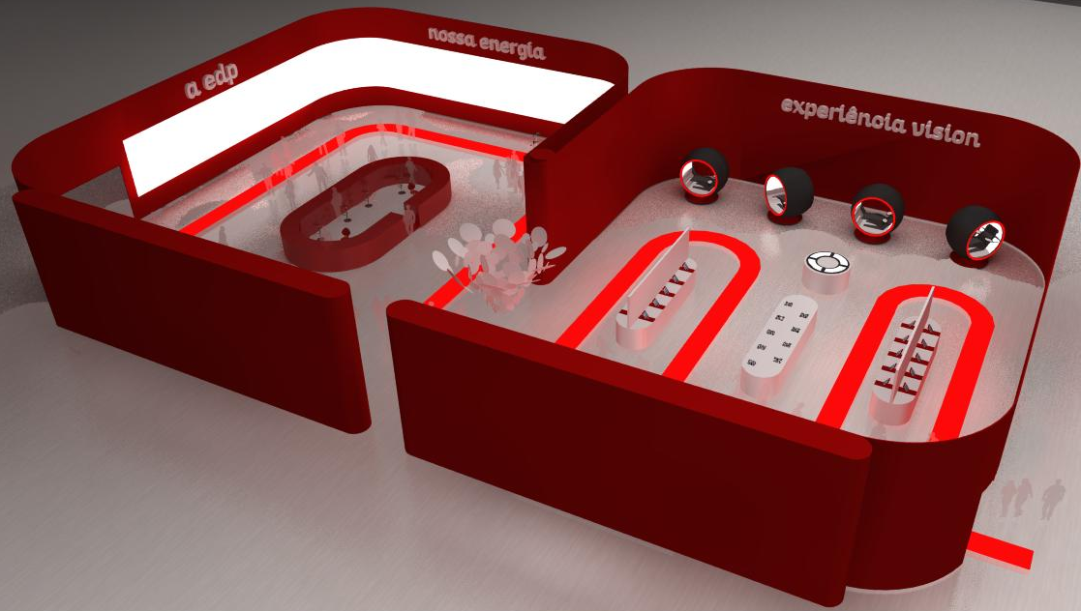
Objective
To research a better and effective future EDP Commercial Store with new technologies.

Slide 4
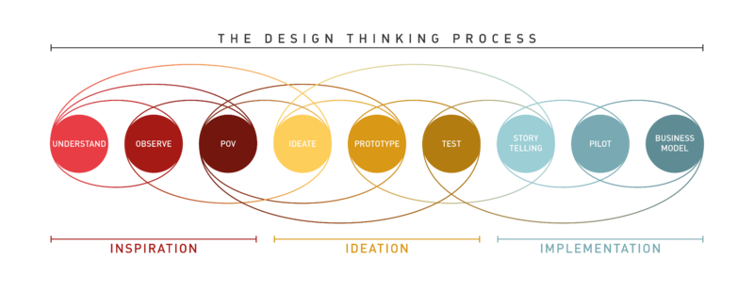
Methodology

Slide 5


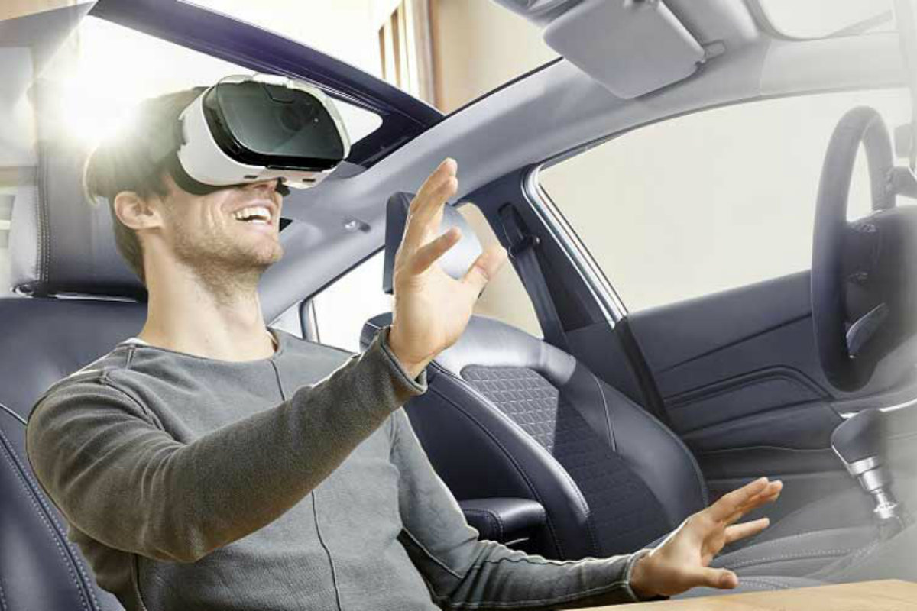
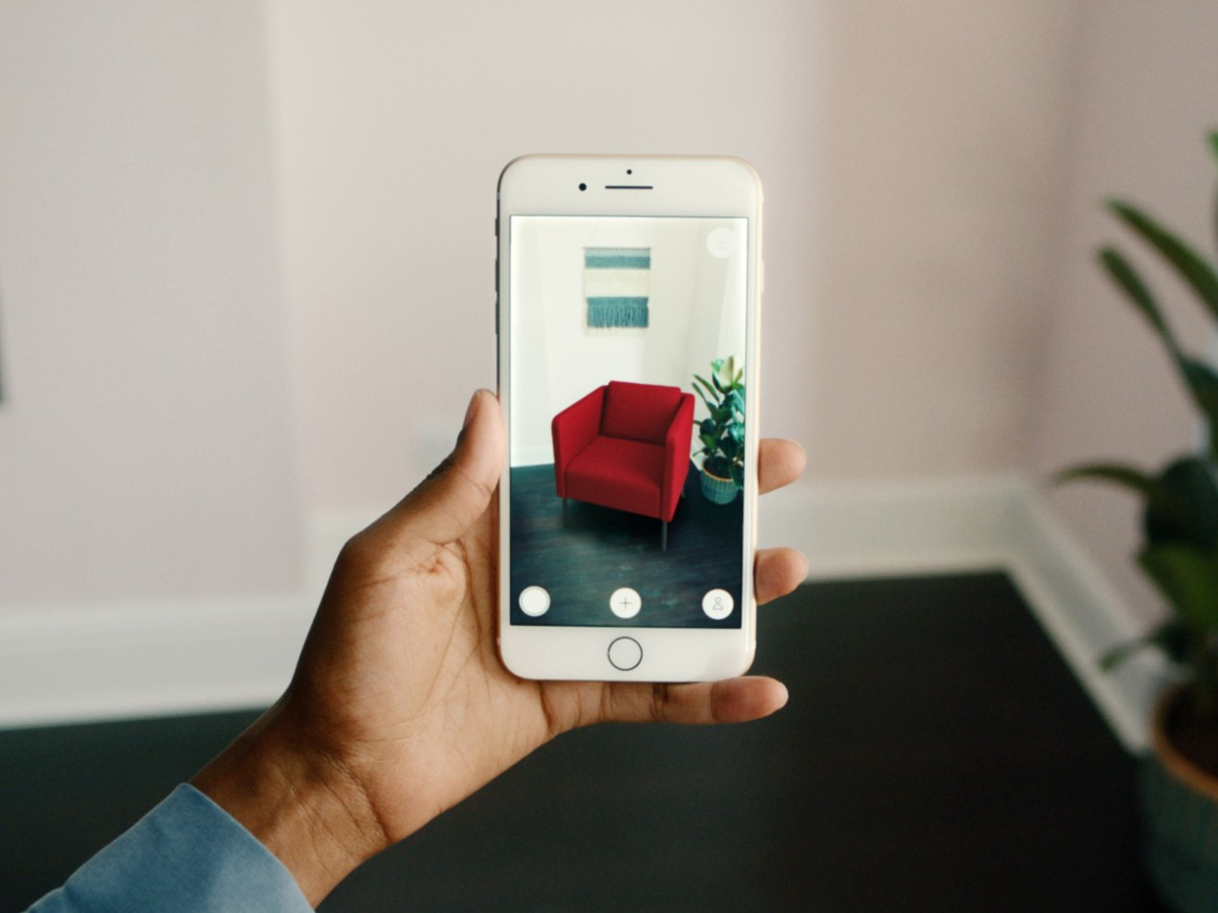
Building the Project
Viro Media e React Native (App) | A-Frame e AR.js (Web)

Slide 6
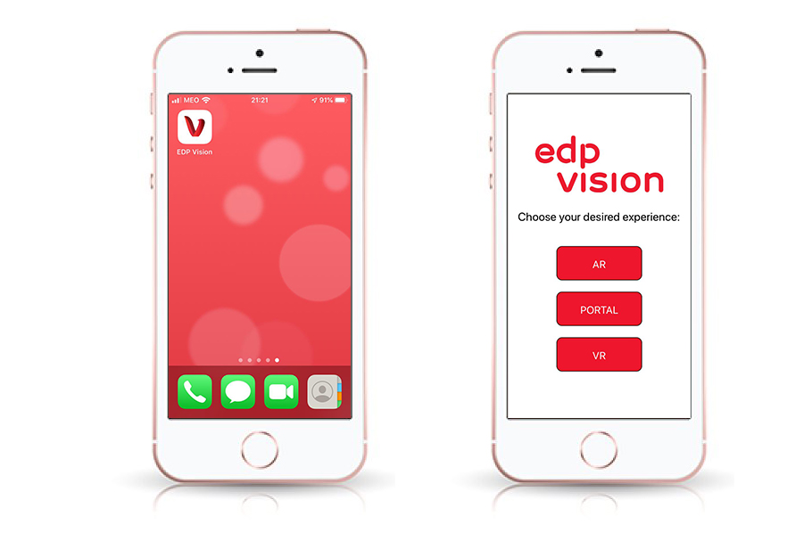
The App

Slide 7
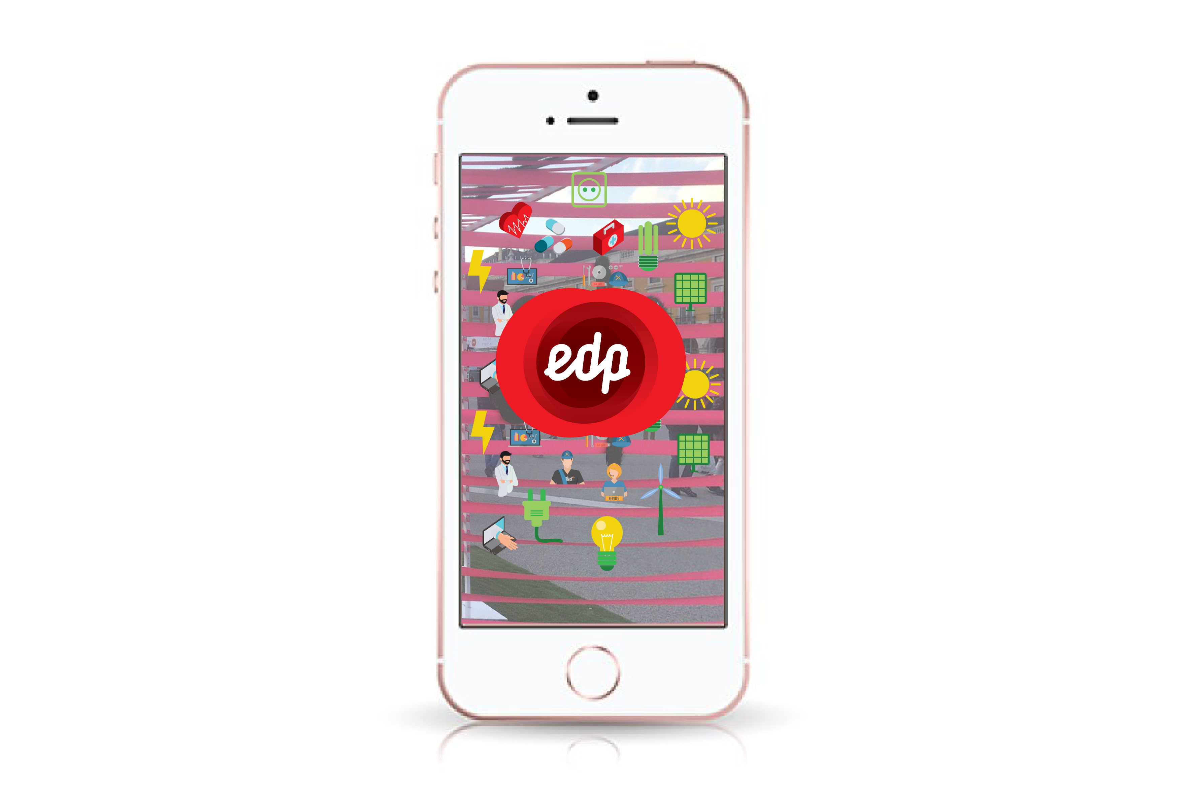
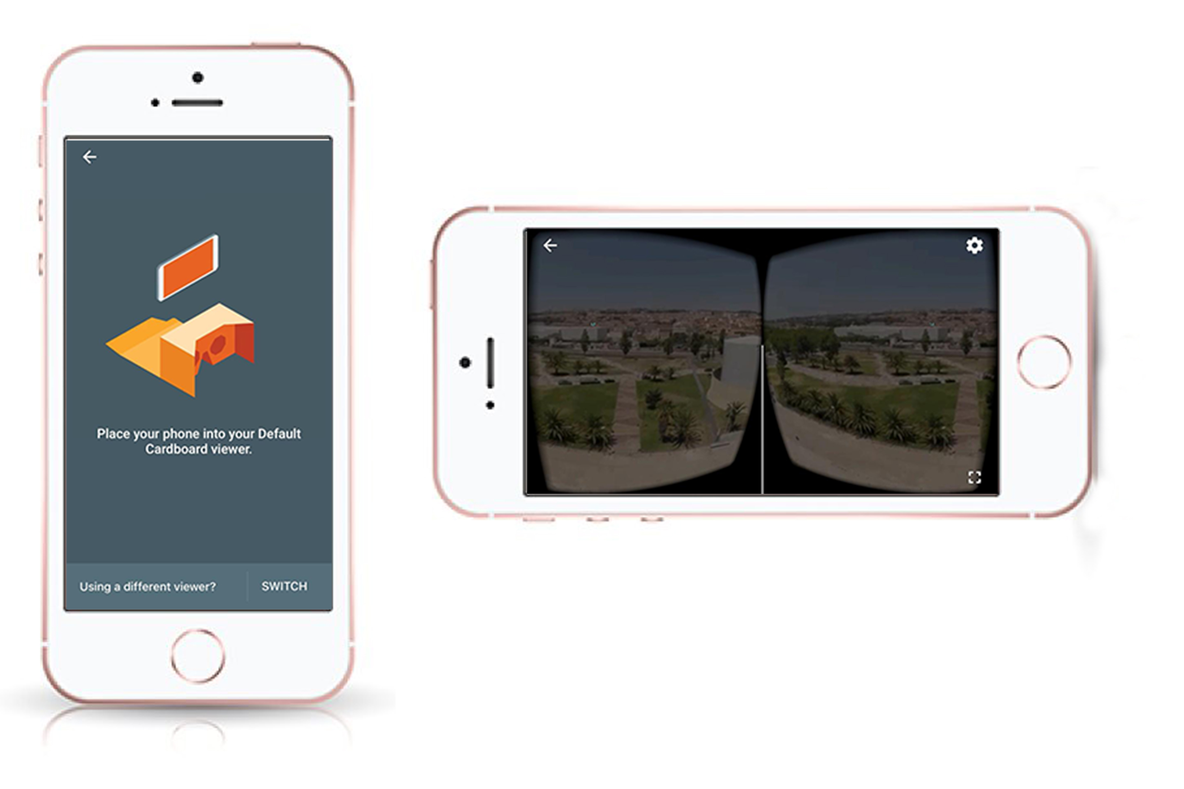
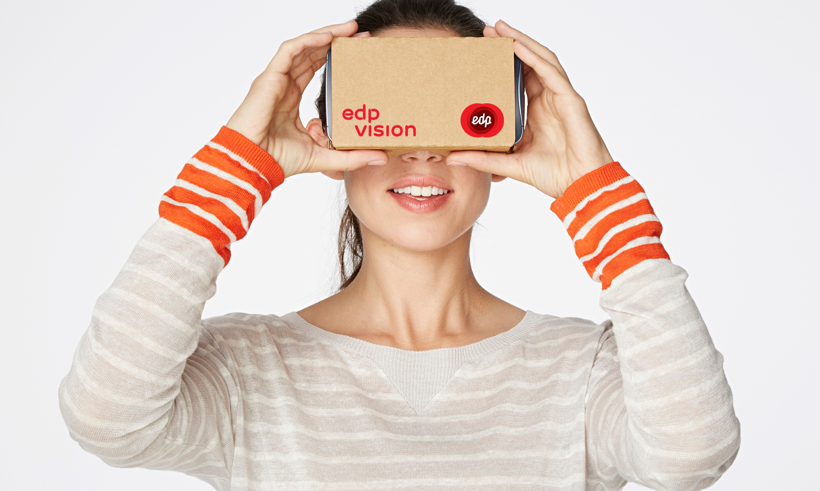
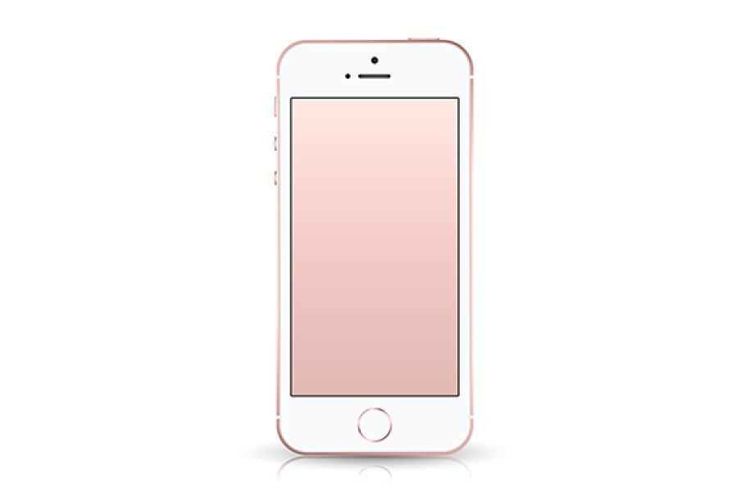
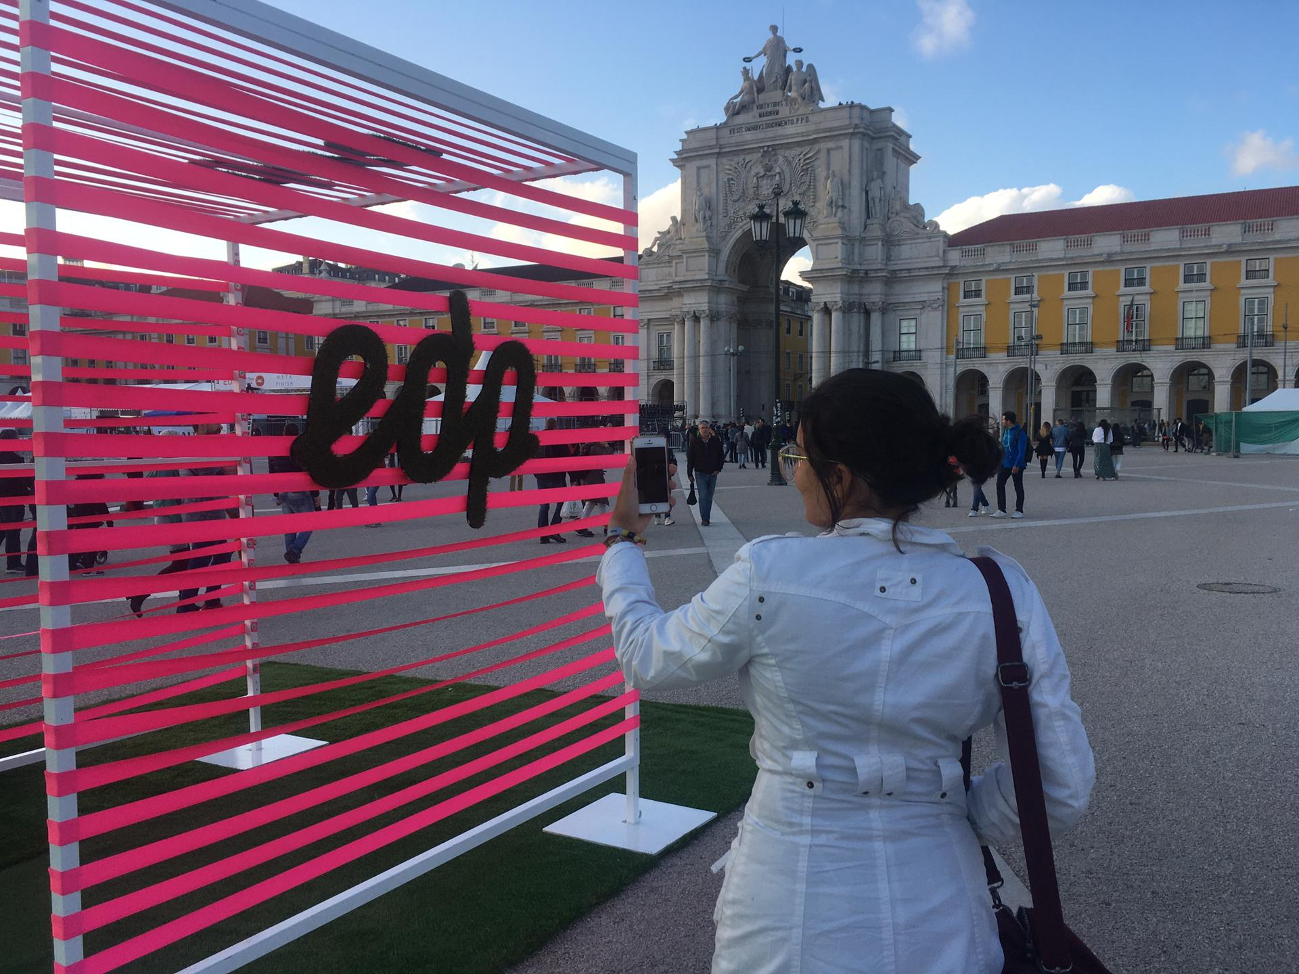
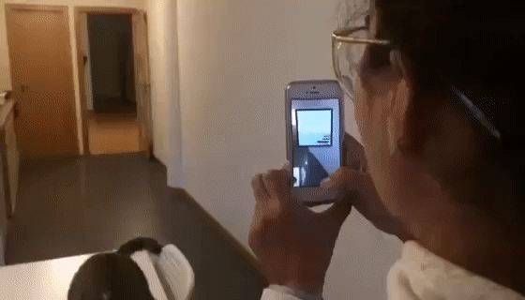
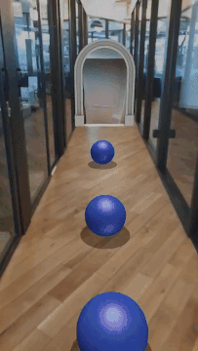
The App

Slide 8
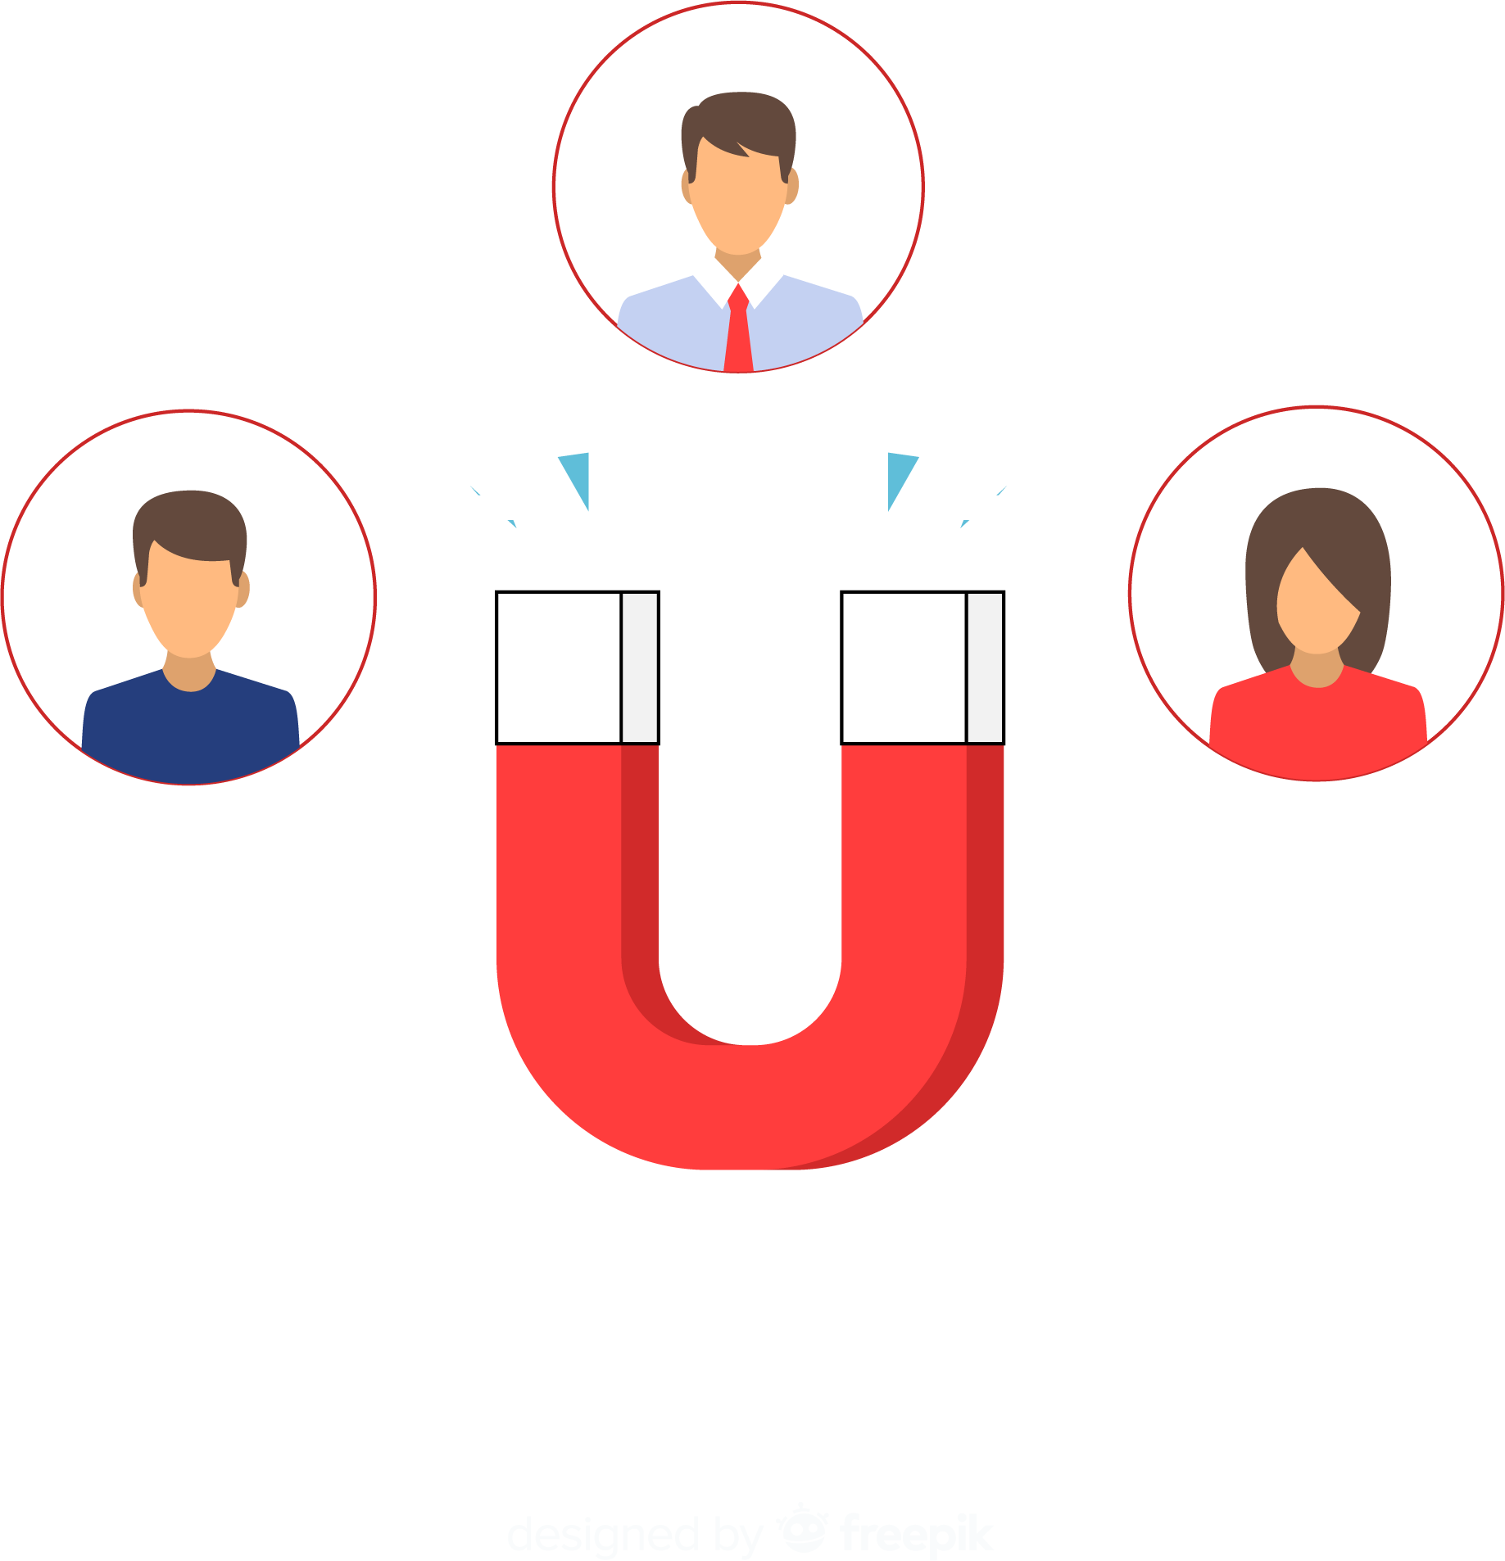
Customer Value
Innovative Customer Experience.
Gamification.
Customer Takes Store to Home.
Learning About Products and Benefits.

Slide 9

Revenue
Builds Customer Loyalty.
Attraction to New Customers.
Marketing and Brand Building of Values.
Opens New Sales Channel with Costumers.

Slide 10
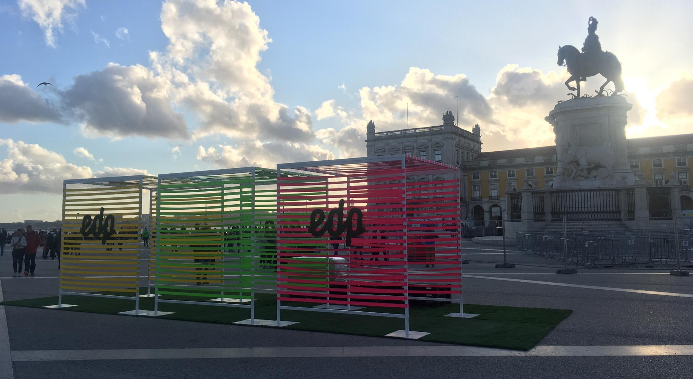
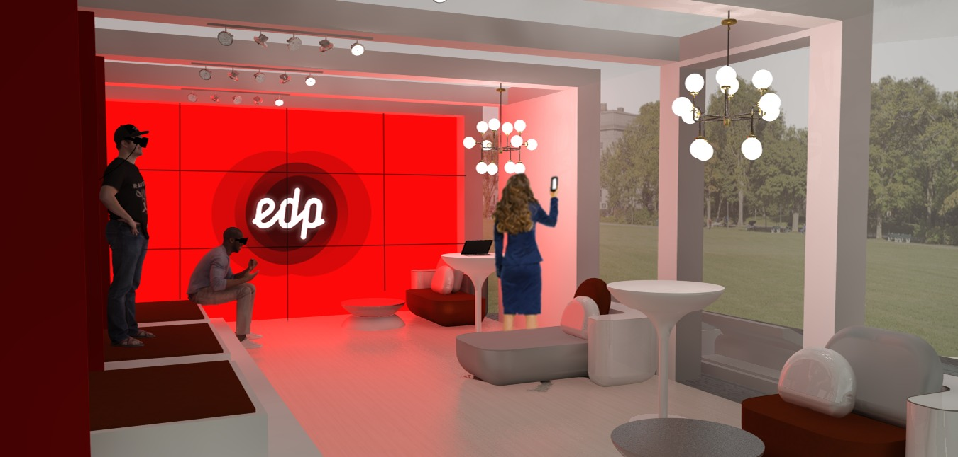
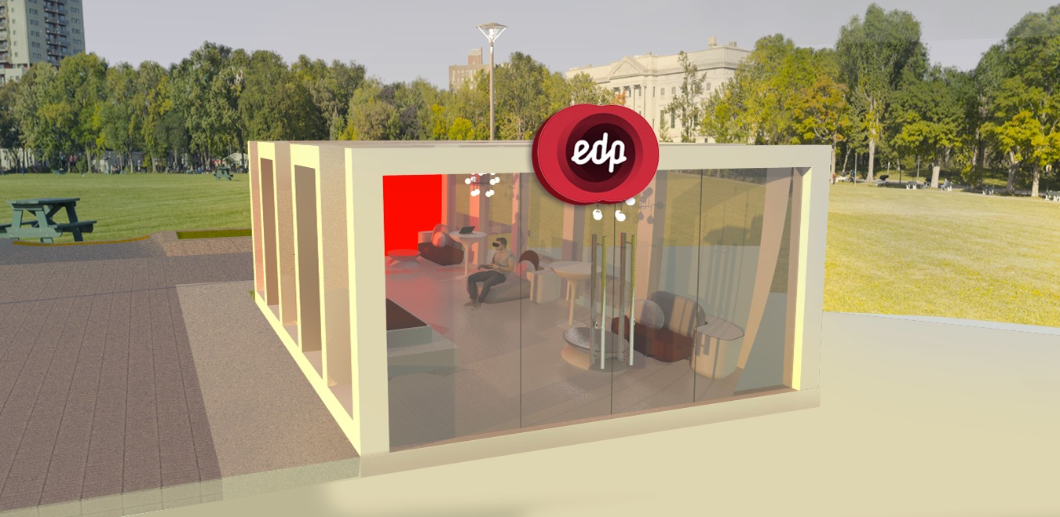
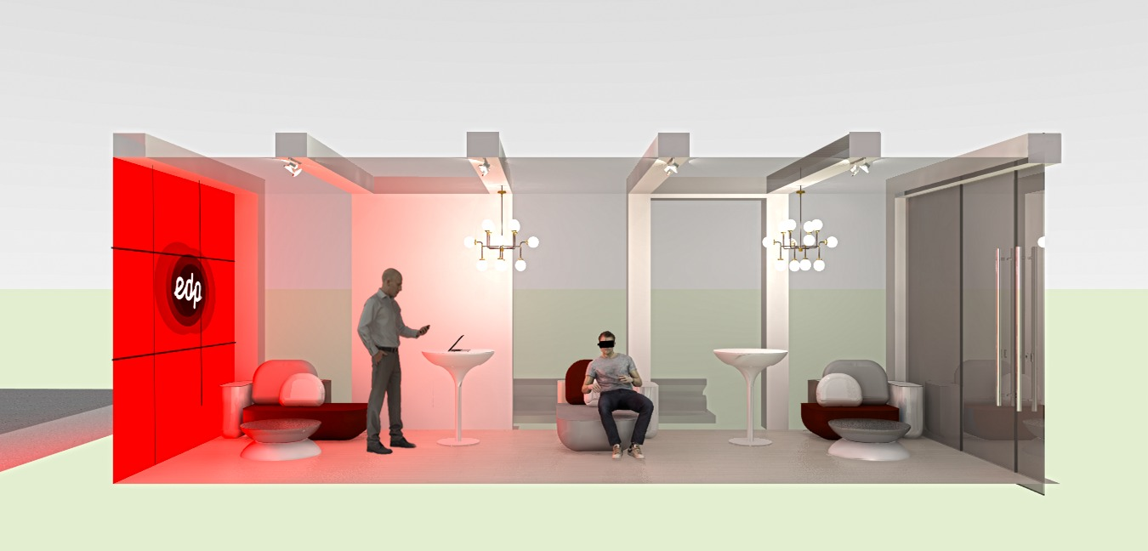
Concept Pop-up Store

Slide 11
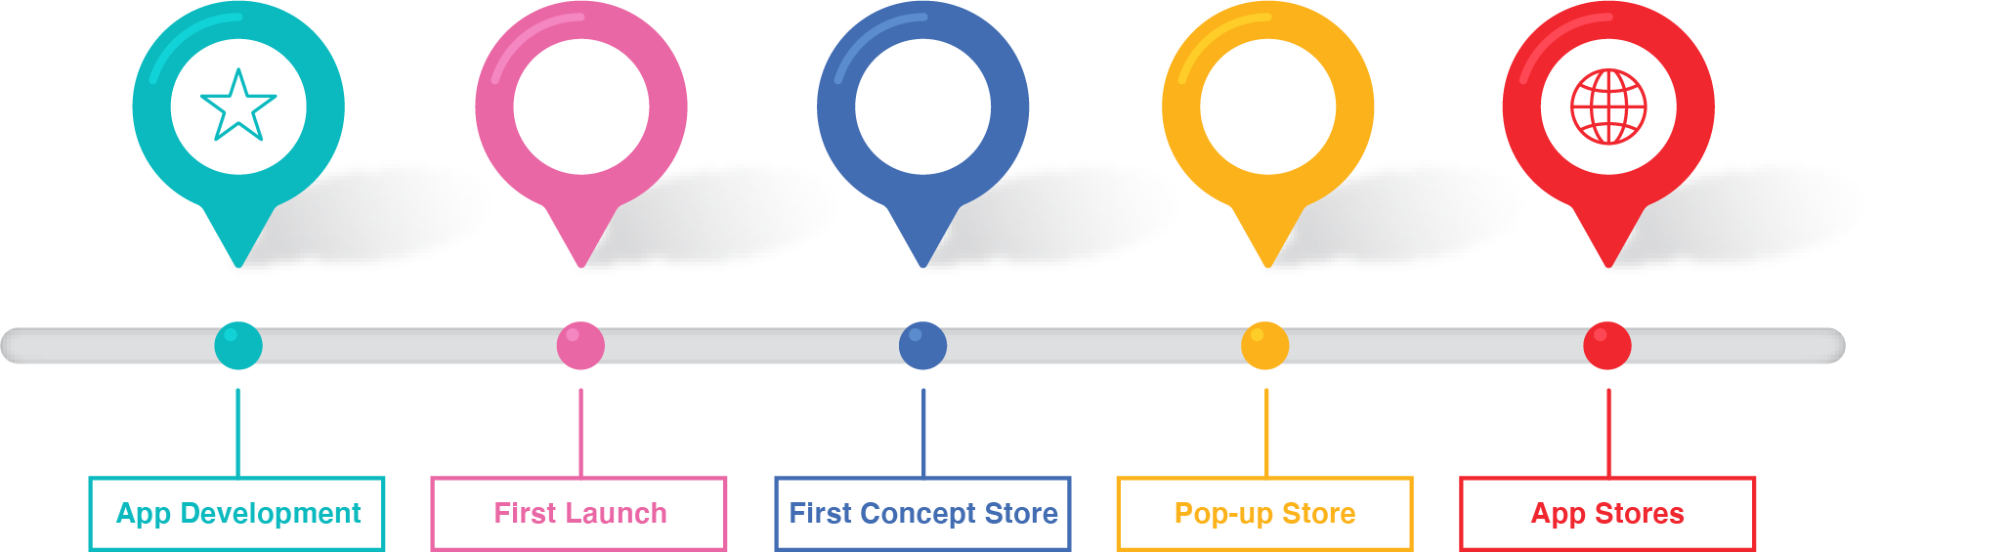
The Project
3 to 6 months: development for the Application.
6 months: Test with public at an event.
8 months: Open of the First Concept Store.
10 months: Pop-up Store events.
12+ months: Launch on Appstore and Google Play.

Slide 12
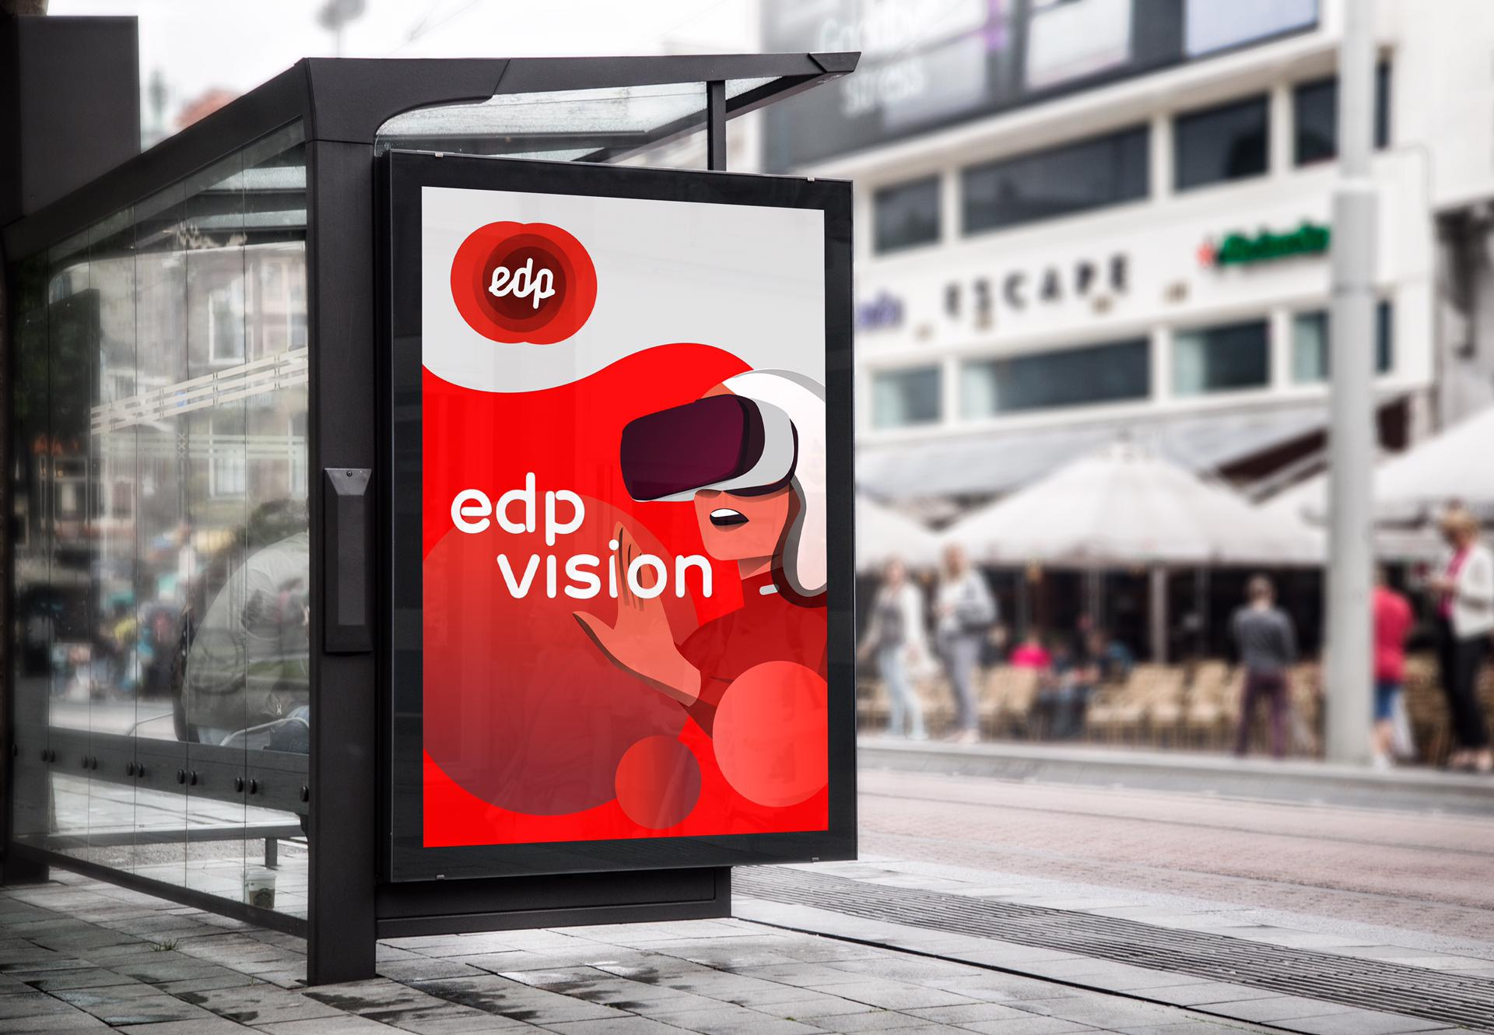
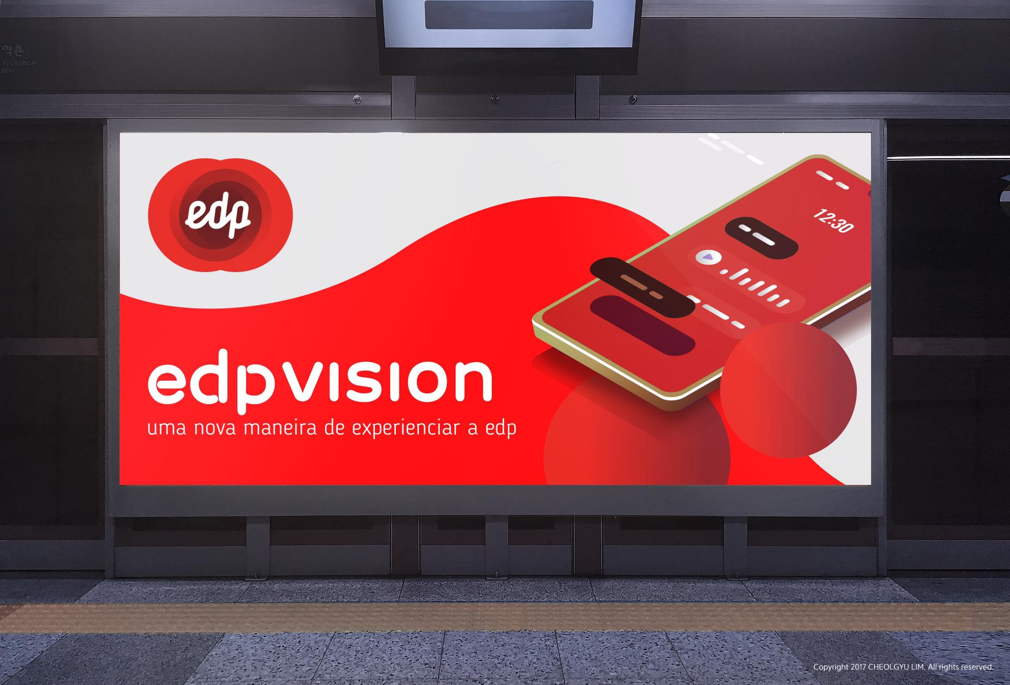
EDP Vision

Slide 13
THANK YOU

